Slide 1
ECE 271
Electronic Circuits I
Topic 9 MOS Memory and Storage Circuits

Slide 2
Chapter Goals
Overall memory chip organization
Static memory circuits using the six-transistor cell
Dynamic memory circuits
Sense amplifier circuits used to read data from memory cells
Learn about row and address decoders
Implementation of CPU registers via flip-flops
Pass transistor logic
Read Only Memory

Slide 3
Memory Types
Read Only Memory (ROM) refers to memory in a digital system that has only read capabilities. Can be used to perform logic operations.
Random Access Memory (RAM) refers to memory in a digital system that has both read and write capabilities. Mostly it’s a high speed temporary storage memory.
Static RAM (SRAM) is able to store its information as long as power is applied, and it does not lose the data during a read cycle (early memory was mostly SRAM)
Dynamic RAM (DRAM) uses a capacitor to temporarily store data which must be refreshed periodically to prevent information loss, and the data is lost in most DRAMs during the read cycle
SRAM takes approximately four times the silicon area of DRAM with the same technology.
Digital systems also include usually high speed small size memory – registers to temporarily store information used in operations.
The memory chip usually includes the storage cells, address decoders - logical circuits for selecting and accessing a particular cell, and sense amplifiers for amplifying the signal retrieved from a cell.

Slide 4
Static Memory Cells
There are two types of basic electronic storage elements – latch and flip-flop.

Slide 5
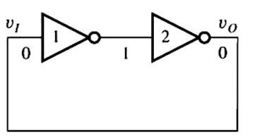
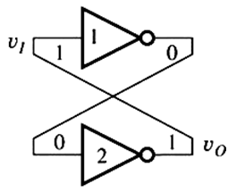
Static Memory Cells
There are two types of basic electronic storage elements – latch and flip-flop.
The latch - a memory cell built from two feedback connected inverters
Latch

Slide 6
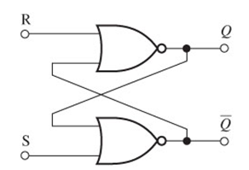
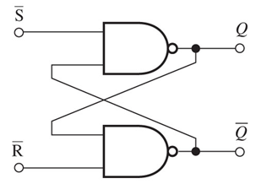
Static Memory Cells
There are two types of basic electronic storage elements – latch and flip-flop.
The latch - a memory cell built from two feedback connected inverters
The set-reset flip-flop (RS-FF) - a memory cell built from two feedback connected NOR or NAND gates.
Latch Flip-Flop

Slide 7
Static Memory Cells
There are two types of basic electronic storage elements – latch and flip-flop.
The latch - a memory cell built from two feedback connected inverters
The set-reset flip-flop (RS-FF) - a memory cell built from two feedback connected NOR or NAND gates.
The circuits use positive feedback to store information.
Latch Flip-Flop

Slide 8
Static Memory Cells
There are two types of basic electronic storage elements – latch and flip-flop.
The latch - a memory cell built from two feedback connected inverters
The set-reset flip-flop (RS-FF) - a memory cell built from two feedback connected NOR or NAND gates.
These circuits use positive feedback to store information.
These circuits have two stable states – bistable circuits.
Latch Flip-Flop

Slide 9
Latch Static Memory Cell
The behavior of the cell can be understood by analyzing its VTC.
3

Slide 10
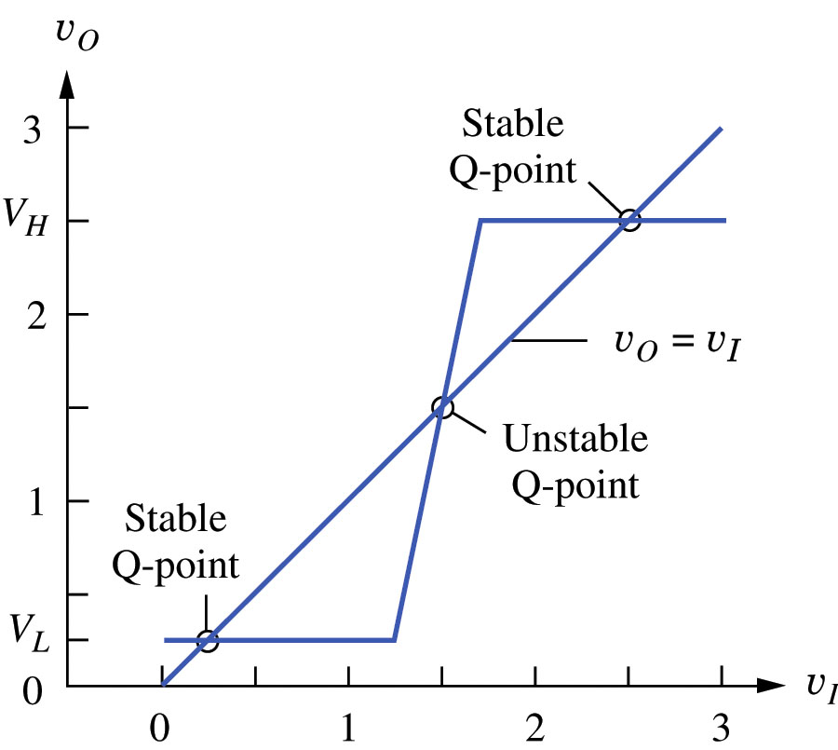

Latch Static Memory Cell
The behavior of the cell can be understood by analyzing its VTC.
Blue curve is the VTC of the two cascaded inverters 1 and 2.
3

Slide 11
Latch Static Memory Cell
The behavior of the cell can be understood by analyzing its VTC.
Blue curve is the VTC of the two cascaded inverters 1 and 2.
The red line (slope=1) is the VTC of the unit feedback 3.
3

Slide 12
Latch Static Memory Cell
The behavior of the cell can be understood by analyzing its VTC.
Blue curve is the VTC of the two cascaded inverters 1 and 2.
The red line (slope=1) is the VTC of the unit feedback 3.
3
The equilibrium operating points are given by the intersection of the two VTC curves.

Slide 13
Latch Static Memory Cell
The behavior of the cell can be understood by analyzing its VTC.
Blue curve is the VTC of the two cascaded inverters 1 and 2.
The red line (slope=1) is the VTC of the unit feedback 3.
3
The equilibrium operating points are given by the intersection of the two VTC curves.
There are two stable Q-points: v_{I} = v_{O} = v_{H} and v_{I} = v_{O} = v_{L} .
Small deviations from those two points will cause the cell to return into themselves.

Slide 14
Latch Static Memory Cell
The behavior of the cell can be understood by analyzing its VTC.
Blue curve is the VTC of the two cascaded inverters 1 and 2.
The red line (slope=1) is the VTC of the unit feedback 3.
3
The equilibrium operating points are given by the intersection of the two VTC curves.
There are two stable Q-points: v_{I} = v_{O} = v_{H} and v_{I} = v_{O} = v_{L} .
Small deviations from those two points will cause the cell to return into themselves.
There is also one unstable Q-point in the middle, where slight changes in the voltage will cause it to latch in one of the stable states

Slide 15
The 6-T Cell
The previous cell can exist indefinitely long in one of the stable states – high or low, i.e. it can store one bit of information – 0 or 1.
However this construction is not yet usable because there is no mechanism to change the state - to “write” the information into sell.

Slide 16
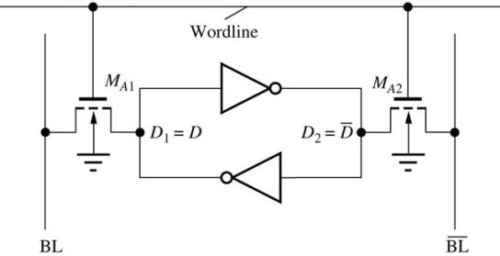
The 6-T Cell
The previous cell can exist indefinitely long in one of the stable states – high or low, i.e. it can store one bit of information – 0 or 1.
However this construction is not yet usable because there is no mechanism to change the state - to “write” the information into sell.
This is accomplished by addition of two control (access) transistors → a called 6-T (6 transistor) cell that can store 0 and 1values of the data and allows to “write” and to “read” that data.
The access transistors also isolate one cell from another in a memory array.

Slide 17
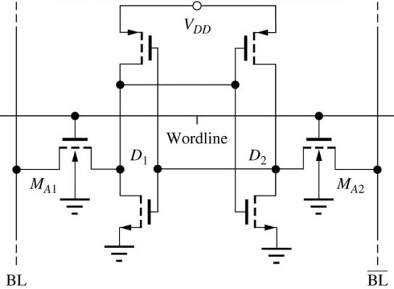
The 6-T Cell
The previous cell can exist indefinitely long in one of the stable states – high or low, i.e. it can store one bit of information – 0 or 1.
However this construction is not yet usable because there is no mechanism to change the state - to “write” the information into sell.
This is accomplished by addition of two control (access) transistors → a so called 6-T (6 transistor) cell that can store 0 and 1values of the data and allows to “write” and to “read” that data.
The access transistors also isolate one cell from another in a memory array.
Substituting the inverters with their CMOS representation, we obtain the circuit implementation of the 6-T SRAM cell.

Slide 18
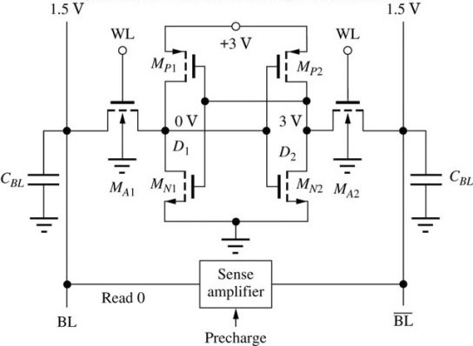
The Read Operation of a 6-T Cell
Consider a 6-T cell with V_{DD} = 3V.

Slide 19
The Read Operation of a 6-T Cell
Consider a 6-T cell with V_{DD} = 3V. Assume that
A “0” in the memory cell corresponds to a low level (0V) on the left data storage node

Slide 20
The Read Operation of a 6-T Cell
Consider a 6-T cell with V_{DD} = 3V. Assume that
A “0” in the memory cell corresponds to a low level (0V) on the left data storage node D₁ , and a high level (3V) on the right data node D₂

Slide 21
The Read Operation of a 6-T Cell
Consider a 6-T cell with V_{DD} = 3V. Assume that
A “0” in the memory cell corresponds to a low level (0V) on the left data storage node D₁ , and a high level (3V) on the right data node D₂
A “1” in the memory cell corresponds to a high level on D₁ , and a low level on D₂ .

Slide 22
The Read Operation of a 6-T Cell
Consider a 6-T cell with V_{DD} = 3V. Assume that
A “0” in the memory cell corresponds to a low level (0V) on the left data storage node D₁ , and a high level (3V) on the right data node D₂
A “1” in the memory cell corresponds to a high level on D₁ , and a low level on D₂ .
Initial state of the cell storing a “0” with the bitlines’ initially precharged to V_{DD}/2 and WL set to 0.
WL=0
WL=0
“0”

Slide 23
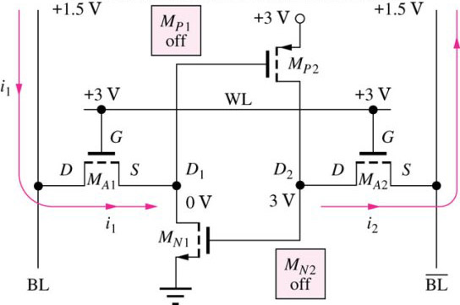

The Read Operation of a 6-T Cell
Consider a 6-T cell with V_{DD} = 3V. Assume that
A “0” in the memory cell corresponds to a low level (0V) on the left data storage node D₁ , and a high level (3V) on the right data node D₂
A “1” in the memory cell corresponds to a high level on D₁ , and a low level on D₂ .
Initial state of the cell storing a “0” with the bitlines’ initially precharged to V_{DD}/2 and WL set to 0.
WL=0
WL=0
WL=0
WL=0
“0”
“0”

Slide 24
The Read Operation of a 6-T Cell
Consider a 6-T cell with V_{DD} = 3V. Assume that
A “0” in the memory cell corresponds to a low level (0V) on the left data storage node D₁ , and a high level (3V) on the right data node D₂
A “1” in the memory cell corresponds to a high level on D₁ , and a low level on D₂ .
To read the data we set WL to 3V,
Initial state of the cell storing a “0” with the bitlines’ initially precharged to V_{DD}/2 and WL set to 0.
WL=0
WL=0
“0”
“0”

Slide 25
The Read Operation of a 6-T Cell
Consider a 6-T cell with V_{DD} = 3V. Assume that
A “0” in the memory cell corresponds to a low level (0V) on the left data storage node D₁ , and a high level (3V) on the right data node D₂ .
A “1” in the memory cell corresponds to a high level on D₁ , and a low level on D₂ .
To read the data we set WL to 3V, which sets WL transistors ON:
M_{A1} – in triode (V_{GS} =?, V_{DS} = ?),
Initial state of the cell storing a “0” with the bitlines’ initially precharged to V_{DD}/2 and WL set to 0.
WL=0
WL=0
“0”
“0”

Slide 26
The Read Operation of a 6-T Cell
Consider a 6-T cell with V_{DD} = 3V. Assume that
A “0” in the memory cell corresponds to a low level (0V) on the left data storage node D₁ , and a high level (3V) on the right data node D₂ .
A “1” in the memory cell corresponds to a high level on D₁ , and a low level on D₂ .
To read the data we set WL to 3V, which sets WL transistors ON:
M_{A1} – in triode (V_{GS} =3, V_{DS} =1.5), i₁ goes from bitline to cell
Initial state of the cell storing a “0” with the bitlines’ initially precharged to V_{DD}/2 and WL set to 0.
WL=0
WL=0
“0”
“0”

Slide 27
The Read Operation of a 6-T Cell
Consider a 6-T cell with V_{DD} = 3V. Assume that
A “0” in the memory cell corresponds to a low level (0V) on the left data storage node D₁ , and a high level (3V) on the right data node D₂ .
A “1” in the memory cell corresponds to a high level on D₁ , and a low level on D₂ .
To read the data we set WL to 3V, which sets WL transistors ON:
M_{A1} – in triode (V_{GS} =3, V_{DS} =1.5), i₁ goes from bitline to cell
M_{A2} – in saturation (V_{GS} = ? , V_{DS} = ? ),
Initial state of the cell storing a “0” with the bitlines’ initially precharged to V_{DD}/2 and WL set to 0.
WL=0
WL=0
“0”
“0”

Slide 28
The Read Operation of a 6-T Cell
Consider a 6-T cell with V_{DD} = 3V. Assume that
A “0” in the memory cell corresponds to a low level (0V) on the left data storage node D₁ , and a high level (3V) on the right data node D₂ .
A “1” in the memory cell corresponds to a high level on D₁ , and a low level on D₂ .
To read the data we set WL to 3V, which sets WL transistors ON:
M_{A1} – in triode (V_{GS} =3, V_{DS} =1.5), i₁ goes from bitline to cell
M_{A2} – in saturation (V_{GS} =1.5, V_{DS} =1.5), i₂ goes from cell to bitline
Initial state of the cell storing a “0” with the bitlines’ initially precharged to V_{DD}/2 and WL set to 0.
WL=0
WL=0
“0”
“0”

Slide 29
The Read Operation of a 6-T Cell
Consider a 6-T cell with V_{DD} = 3V. Assume that
A “0” in the memory cell corresponds to a low level (0V) on the left data storage node D₁ , and a high level (3V) on the right data node D₂ .
A “1” in the memory cell corresponds to a high level on D₁ , and a low level on D₂ .
To read the data we set WL to 3V, which sets WL transistors ON:
M_{A1} – in triode (V_{GS} =3, V_{DS} =1.5), i₁ goes from bitline to cell
M_{A2} – in saturation (V_{GS} =1.5, V_{DS} =1.5), i₂ goes from cell to bitline
Currents i₁ and i₂ are sensed by sense amplifier, which helps to set BL to 0V and BL to 3V.
Initial state of the cell storing a “0” with the bitlines’ initially precharged to V_{DD}/2 and WL set to 0.
Init value of CBL
Init value of not-CBL
WL=0
WL=0
“0”
“0”

Slide 30
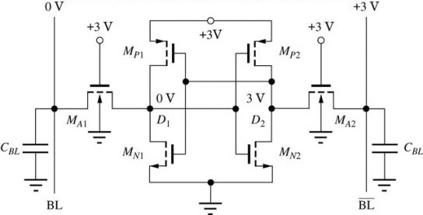
The Read Operation of a 6-T Cell
Final read state condition of the 6-T cell
“0”

Slide 31
The Read Operation of a 6-T Cell
Final read state condition of the 6-T cell
M_{A1} , M_{A1} – both in triode, with zero current because V_{DS} = 0.
“0”

Slide 32
The Read Operation of a 6-T Cell
Final read state condition of the 6-T cell
M_{A1} , M_{A1} – both in triode, with zero current because V_{DS} = 0.
Reading means that BL and BL assumed the state of the cell (the same voltages as the cell in “0” state).
“0”

Slide 33
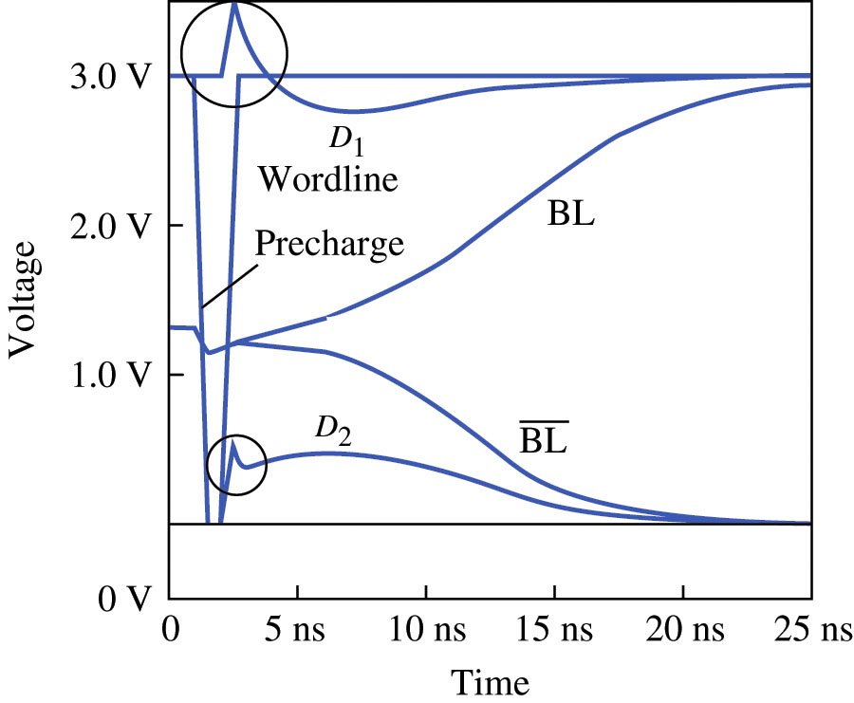
The Read Operation of a 6-T Cell
At t =1ns the precharge of 1.5V is removed.
At t =1ns the worldline begins transition from 0 to 3V.

Slide 34
The Read Operation of a 6-T Cell
At t =1ns the precharge of 1.5V is removed.
At t =1ns the worldline begins transition from 0 to 3V.
Reading a 6-T cell that is storing a “1” follows the same concept as before, except that the sources and drains of the WL transistors are switched

Slide 35

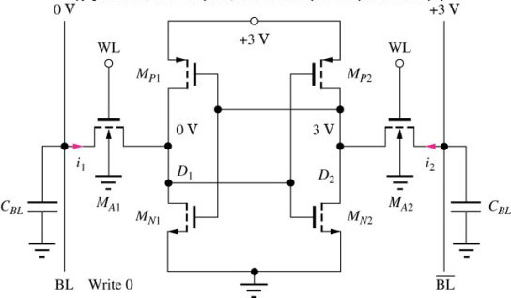
The Write Operation of a 6-T Cell
For the write operation, the bitlines are set with the data that is to be written into the cell. We will study how to write a “0” to a cell.
“0”

Slide 36
The Write Operation of a 6-T Cell
For the write operation, the bitlines are set with the data that is to be written into the cell. We will study how to write a “0” to a cell.
First consider the case when the cell is in “0” state.
“0”
“0”

Slide 37
The Write Operation of a 6-T Cell
For the write operation, the bitlines are set with the data that is to be written into the cell. We will study how to write a “0” to a cell.
First consider the case when the cell is in “0” state.
When we set the bitlines to the same voltage then the cell, it can be seen that not much happens. The access transistors have V_{DS} = 0 and the currents i₁ and i₂ are also zero.
“0”
“0”

Slide 38
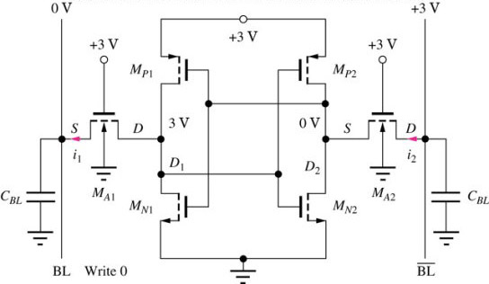
The Write Operation of a 6-T Cell
Now lets consider writing a “0” to a cell that is storing a “1”.
WL
WL
“0”
“1”

Slide 39
The Write Operation of a 6-T Cell
Now lets consider writing a “0” to a cell that is storing a “1”.
The writing begins with setting worldline to 3V.
“0”
“1”

Slide 40
The Write Operation of a 6-T Cell
Now lets consider writing a “0” to a cell that is storing a “1”.
The writing begins with setting worldline to 3V.
Access transistor M_{A1} conducts current in saturation region (V_{GS} =3, V_{DS} =3) and the voltage on D₁ goes toward 0.
“0”
“1”

Slide 41
The Write Operation of a 6-T Cell
Now lets consider writing a “0” to a cell that is storing a “1”.
The writing begins with setting worldline to 3V.
Access transistor M_{A1} conducts current in saturation region (V_{GS} =3, V_{DS} =3) and the voltage on D₁ goes toward 0.
Access transistor M_{A2} also conducts current in saturation region (V_{GS} =3, V_{DS} =3) and the voltage on D₂ goes toward (3- V_{TN}).
“0”
“1”

Slide 42
The Write Operation of a 6-T Cell
Now lets consider writing a “0” to a cell that is storing a “1”.
The writing begins with setting worldline to 3V.
Access transistor M_{A1} conducts current in saturation region (V_{GS} =3, V_{DS} =3) and the voltage on D₁ goes toward 0.
Access transistor M_{A2} also conducts current in saturation region (V_{GS} =3, V_{DS} =3) and the voltage on D₂ goes toward (3- V_{TN}).
As soon as voltage on D₂ exceeds voltage on D₁ , the positive feedback takes over and quickly brings the cell to the new state (D₁ =0 , D₂ =1) .
“0”
0V
“0”
3V

Slide 43
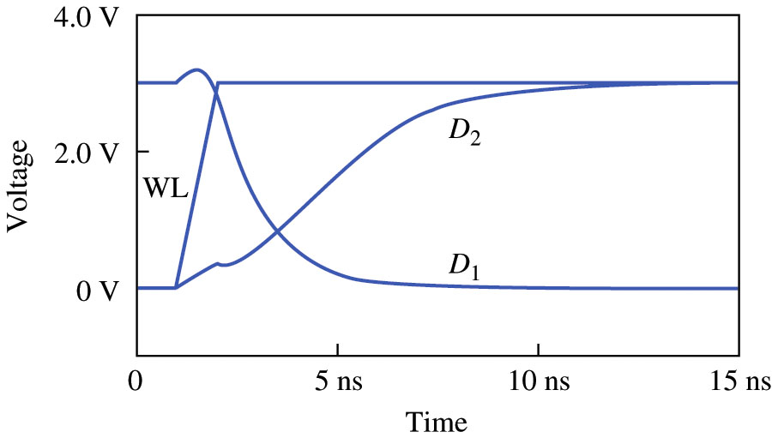
The Write Operation of a 6-T Cell

Slide 44
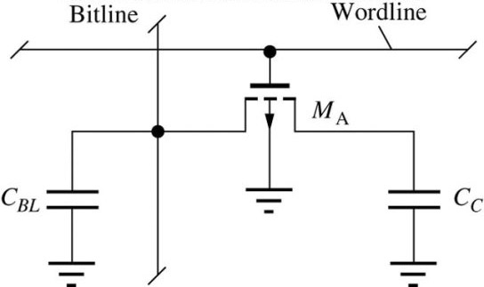
Dynamic Memory Cells
In the static memory cell, the data can be stored indefinitely as long as power is applied.
The pay for this convenience is the amount of transistors -- 6 per cell.
If we drop this requirements, we can create a dynamic memory cell with one transistor -- the 1-T cell, which uses a capacitor as a storage element, where data is represented as either a presence or absence of a charge (below)
However, due to leakage currents in M_{A}, the data will eventually be lost, hence it needs to be refreshed (read and then written back) periodically.

Slide 45

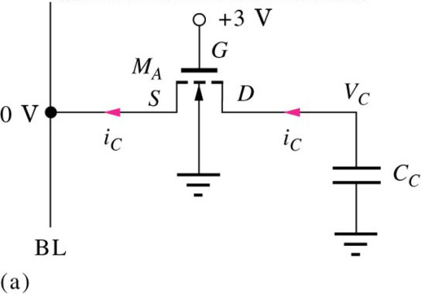
Data Storage in a 1-T Cell
A “0” is represented by 0V, and a “1” by V_{H}.
The data are written into 1-T cell by placing the desired voltage level on the single bitline and turning on access transistor M_{A}.

Slide 46
The Write Operation in a 1-T Cell
A “0” is represented by 0V, and a “1” by V_{H}.
The data are written into 1-T cell by placing the desired voltage level on the single bitline and turning on access transistor M_{A}.
“0”
Storing a “0”

Slide 47
The Write Operation in a 1-T Cell
A “0” is represented by 0V, and a “1” by V_{H}.
The data are written into 1-T cell by placing the desired voltage level on the single bitline and turning on access transistor M_{A}.
“0”
Storing a “0”
Bitline is set to 0V

Slide 48
The Write Operation in a 1-T Cell
A “0” is represented by 0V, and a “1” by V_{H}.
The data are written into 1-T cell by placing the desired voltage level on the single bitline and turning on access transistor M_{A}.
“0”
Storing a “0”
Bitline is set to 0V
The gate voltage is set to V_{GG} =3V

Slide 49
The Write Operation in a 1-T Cell
A “0” is represented by 0V, and a “1” by V_{H}.
The data are written into 1-T cell by placing the desired voltage level on the single bitline and turning on access transistor M_{A}.
“0”
Storing a “0”
Bitline is set to 0V
The gate voltage is set to V_{GG} =3V
The bitline terminal of the M_{A} acts like a source.

Slide 50
The Write Operation in a 1-T Cell
A “0” is represented by 0V, and a “1” by V_{H}.
The data are written into 1-T cell by placing the desired voltage level on the single bitline and turning on access transistor M_{A}.
“0”
Storing a “0”
Bitline is set to 0V
The gate voltage is set to V_{GG} =3V
The bitline terminal of the M_{A} acts like a source.
If the cell voltage is already 0 (v_{C} = 0), V_{DS} = 0 → V_{GS} -V_{TN} > V_{DS} (triode region) → i_{C} =0, v_{C} stays zero (nothing happens).
v_{C} =0
i_{C} =0
i_{C}=0
“0”

Slide 51
The Write Operation in a 1-T Cell
A “0” is represented by 0V, and a “1” by V_{H}.
The data are written into 1-T cell by placing the desired voltage level on the single bitline and turning on access transistor M_{A}.
“0”
Storing a “0”
Bitline is set to 0V
The gate voltage is set to V_{GG} =3V
The bitline terminal of the M_{A} acts like a source.
If the cell voltage is already 0 (v_{C} = 0), V_{DS} = 0 → V_{GS} -V_{TN} > V_{DS} (triode region) → i_{C} =0, v_{C} stays zero (nothing happens).
If the cell has a “1”, with v_{C} > 0 , then V_{DS} >0 (triode or saturation region)
v_{C} >0
“1”

Slide 52
The Write Operation in a 1-T Cell
A “0” is represented by 0V, and a “1” by V_{H}.
The data are written into 1-T cell by placing the desired voltage level on the single bitline and turning on access transistor M_{A}.
“0”
Storing a “0”
Bitline is set to 0V
The gate voltage is set to V_{GG} =3V
The bitline terminal of the M_{A} acts like a source.
If the cell voltage is already 0 (v_{C} = 0), V_{DS} = 0 → V_{GS} -V_{TN} > V_{DS} (triode region) → i_{C} =0, v_{C} stays zero (nothing happens).
If the cell has a “1”, with v_{C} > 0 , then V_{DS} >0 (triode or saturation region), and current i_{C} > 0
v_{C} >0
i_{C} >0
i_{C}>0
“1”

Slide 53
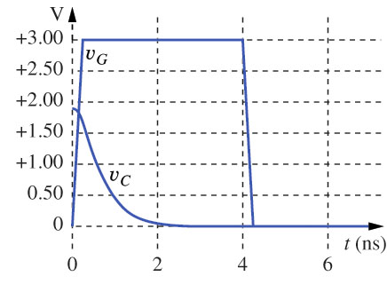
The Write Operation in a 1-T Cell
A “0” is represented by 0V, and a “1” by V_{H}.
The data are written into 1-T cell by placing the desired voltage level on the single bitline and turning on access transistor M_{A}.
“0”
Storing a “0”
Bitline is set to 0V
The gate voltage is set to V_{DD} =3V
The bitline terminal of the M_{A} acts like a source.
If the cell voltage is already 0 (v_{C} = 0), V_{DS} = 0 → V_{GS} -V_{TN} > V_{DS} (triode region) → i_{C} =0, v_{C} stays zero (nothing happens).
If the cell has a “1”, with v_{C} > 0 , then V_{DS} >0 (triode or saturation region), and current i_{C} > 0 will completely discharge C_{C} yielding v_{C} =0.
v_{C} =0
i_{C} =0
i_{C}=0
“0”

Slide 54
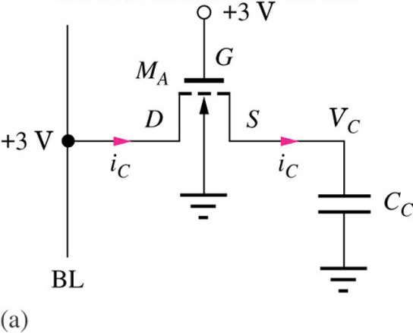
The Write Operation in a 1-T Cell
Storing a “1”
“1”

Slide 55
The Write Operation in a 1-T Cell
Storing a “1”
Bitline is set to 3V
“1”

Slide 56
The Write Operation in a 1-T Cell
Storing a “1”
Bitline is set to 3V
The gate voltage is set to V_{GG} =3V
“1”

Slide 57
The Write Operation in a 1-T Cell
Storing a “1”
Bitline is set to 3V
The gate voltage is set to V_{GG} =3V
The bitline terminal of the M_{A} acts like a drain. V_{GS} =V_{DS} and M_{A} is set into saturation region
Since V_{GS} is determined by v_{C} , (V_{GS} = V_{GG} - v_{C} ) the further events will depend on the value of v_{C .}
“1”

Slide 58
The Write Operation in a 1-T Cell
Storing a “1”
Bitline is set to 3V
The gate voltage is set to V_{GG} =3V
The bitline terminal of the M_{A} acts like a drain. V_{GS} =V_{DS} and M_{A} is set into saturation region
Since V_{GS} is determined by v_{C} , (V_{GS} = V_{GG} - v_{C} ) the further events will depend on the value of v_{C .}
If v_{C} is at the high level (will be determined later), M_{A} will not conduct, i_{C} =0, and nothing changes in the circuit – it stays in “1”.
“1”
v_{C} =V_{H}
i_{C} =0
i_{C}=0
“1”

Slide 59
The Write Operation in a 1-T Cell
Storing a “1”
Bitline is set to 3V
The gate voltage is set to V_{GG} =3V
The bitline terminal of the M_{A} acts like a drain. V_{GS} =V_{DS} and M_{A} is set into saturation region
Since V_{GS} is determined by v_{C} , (V_{GS} = V_{GG} - v_{C} ) the further events will depend on the value of v_{C .}
If v_{C} is at the high level (will be determined later), M_{A} will not conduct, i_{C} =0, and nothing changes in the circuit – it stays in “1”.
If v_{C} =0 (cell is in “0”) or is so small that V_{GS} > V_{TN} , then M_{A} will conduct and current i_{C} will charge the capacitor until v_{C} reaches the value at which the current will stop.
“1”
v_{C} =0
“0”

Slide 60
The Write Operation in a 1-T Cell
Storing a “1”
Bitline is set to 3V
The gate voltage is set to V_{GG} =3V
The bitline terminal of the M_{A} acts like a drain. V_{GS} =V_{DS} and M_{A} is set into saturation region
Since V_{GS} is determined by v_{C} , (V_{GS} = V_{GG} - v_{C} ) the further events will depend on the value of v_{C .}
If v_{C} is at the high level (will be determined later), M_{A} will not conduct, i_{C} =0, and nothing changes in the circuit – it stays in “1”.
If v_{C} =0 (cell is in “0”) or is so small that V_{GS} > V_{TN} , then M_{A} will conduct and current i_{C} will charge the capacitor until v_{C} reaches the value at which the current will stop.
That will happen when V_{GS} =V_{TN} or v_{C} = V_{GG} -V_{TN}
at which point the cell comes to “1” state thus v_{C} = 3-V_{TN} will correspond to the “1” .
“1”
v_{C} =3- V_{TN}
i_{C} =0
i_{C}=0
“1”

Slide 61
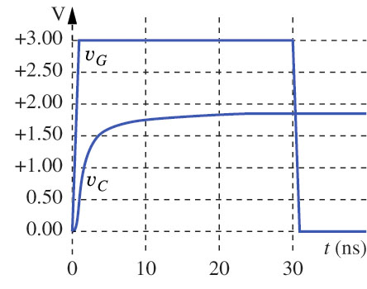
The Write Operation in a 1-T Cell
Storing a “1”
Bitline is set to 3V
The gate voltage is set to V_{GG} =3V
The bitline terminal of the M_{A} acts like a drain. V_{GS} =V_{DS} and M_{A} is set into saturation region
Since V_{GS} is determined by v_{C} , (V_{GS} = V_{GG} - v_{C} ) the further events will depend on the value of v_{C .}
If v_{C} is at the high level (will be determined later), M_{A} will not conduct, i_{C} =0, and nothing changes in the circuit – it stays in “1”.
If v_{C} =0 (cell is in “0”) or is so small that V_{GS} > V_{TN} , then M_{A} will conduct and current i_{C} will charge the capacitor until v_{C} reaches the value at which the current will stop.
That will happen when V_{GS} =V_{TN} or v_{C} = V_{GG} -V_{TN}
at which point the cell comes to “1” state thus v_{C} = 3-V_{TN} will correspond to the “1” .
Notice that the voltage stored on the storage capacitor does not reach V_{GG}
“1”
v_{C} =3- V_{TN}
i_{C} =0
i_{C}=0
“1”

Slide 62
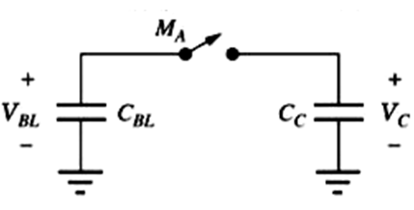
The Read Operation in a 1-T Cell
To read a DRAM cell, the bitline is precharged to V_{DD}/2, and then M_{A} is turned on (WL→3V).

Slide 63
The Read Operation in a 1-T Cell
To read a DRAM cell, the bitline is precharged to V_{DD}/2, and then M_{A} is turned on (WL→3V).
The charge stored on C_{C} will be shared with C_{BL} through the process of charge sharing.

Slide 64
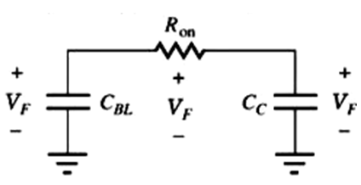
The Read Operation in a 1-T Cell
To read a DRAM cell, the bitline is precharged to V_{DD}/2, and then M_{A} is turned on (WL→3V).
The charge stored on C_{C} will be shared with C_{BL} through the process of charge sharing.
When M_{A} is turned on, the current through the small R_{on} will redistribute the charges until the voltages on both will become equal to V_{F} .
V_{BL}
V_{C}

Slide 65
The Read Operation in a 1-T Cell
To read a DRAM cell, the bitline is precharged to V_{DD}/2, and then M_{A} is turned on (WL→3V).
The charge stored on C_{C} will be shared with C_{BL} through the process of charge sharing.
When M_{A} is turned on, the current through the small R_{on} will redistribute the charges until the voltages on both will become equal to V_{F} .
The difference between the original (precharged) V_{BL} and V_{F} will be the “readout” signal.

Slide 66
The Read Operation in a 1-T Cell
To read a DRAM cell, the bitline is precharged to V_{DD}/2, and then M_{A} is turned on (WL→3V).
The charge stored on C_{C} will be shared with C_{BL} through the process of charge sharing.
When M_{A} is turned on, the current through the small R_{on} will redistribute the charges until the voltages on both will become equal to V_{F} .
The difference ΔV between the original (precharged) V_{BL} and V_{F} will be the “readout” signal.
From the charge conservation:
Thus and

Slide 67
The Read Operation in a 1-T Cell
To read a DRAM cell, the bitline is precharged to V_{DD}/2, and then M_{A} is turned on (WL→3V).
The charge stored on C_{C} will be shared with C_{BL} through the process of charge sharing.
When M_{A} is turned on, the current through the small R_{on} will redistribute the charges until the voltages on both will become equal to V_{F} .
The difference ΔV between the original (precharged) V_{BL} and V_{F} will be the “readout” signal.
From the charge conservation:
Thus and
We see that
1) readout signal is quite small → requires amplifier (for C_{BL} =10C_{C} , V_{GG} =1.8, ΔV =90mV)
2) the content of the cell is destroyed during reading → requires immediate restoration

Slide 68
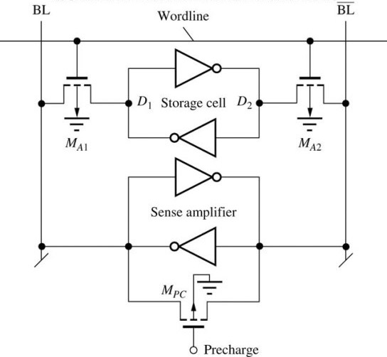
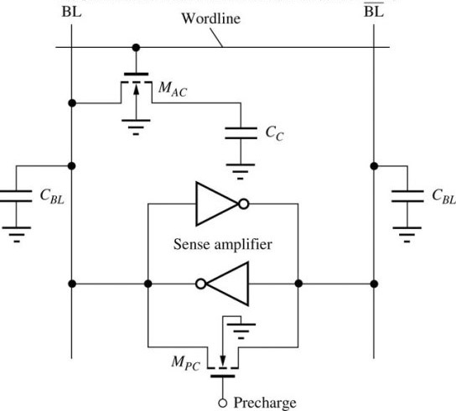

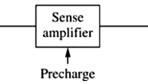
Sense Amplifiers
Sense amplifiers are used to detect the small currents that flow through the access transistors or the small voltage differences that occur during charge sharing.
One sense amplifier is associated with each bitline pair.

Slide 69
A Sense Amplifier for the 1-T Cell
The sense amplifier consists of a two-inverter latch plus an additional precharge transistor M_{PC} .

Slide 70
A Sense Amplifier for the 1-T Cell
The sense amplifier consists of a two-inverter latch plus an additional precharge transistor M_{PC} .
The main purpose M_{PC} is to force the latch to operate at the unstable point.

Slide 71
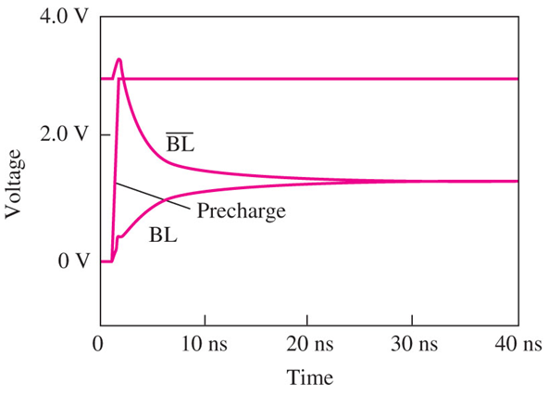
A Sense Amplifier for the 1-T Cell
The sense amplifier consists of a two-inverter latch plus an additional precharge transistor M_{PC} .
The main purpose M_{PC} is to force the latch to operate at the unstable point.
The sequence of events during read operation:
The precharge signal turns on, effectively connecting both bitlines with the small R_{on} and equalizing any voltage difference that existed between bitlines.

Slide 72
A Sense Amplifier for the 1-T Cell
The sense amplifier consists of a two-inverter latch plus an additional precharge transistor M_{PC} .
The main purpose M_{PC} is to force the latch to operate at the unstable point.
The sequence of events during read operation:
The precharge signal turns on, effectively connecting both bitlines with the small R_{on} and equalizing any voltage difference that existed between bitlines.
At the same time it sets the latch into the middle unstable point (v_{i} = v_{o} ).

Slide 73
A Sense Amplifier for the 1-T Cell
The sense amplifier consists of a two-inverter latch plus an additional precharge transistor M_{PC} .
The main purpose M_{PC} is to force the latch to operate at the unstable point.
The sequence of events during read operation:
The precharge signal turns on, effectively connecting both bitlines with the small R_{on} and equalizing any voltage difference that existed between bitlines.
At the same it sets the latch into the middle unstable point (v_{i} = v_{o} ).
After that the precharge signal may go off and the latch will remain in the unstable equilibrium.

Slide 74
A Sense Amplifier for the 1-T Cell
The world line goes up and the charge redistribution occurs, creating a small difference between bitline voltages.

Slide 75
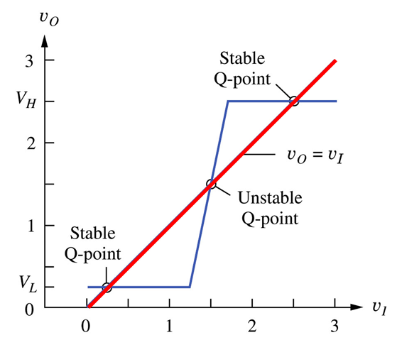
A Sense Amplifier for the 1-T Cell
The world line goes up and the charge redistribution occurs, creating a small difference between bitline voltages.
This small “readout” ΔV reaches the input of the amplifier latch, which is in the middle unstable state and slightly shifts it out of that state into one or another side, depending on the sign of ΔV .

Slide 76
A Sense Amplifier for the 1-T Cell
The world line goes up and the charge redistribution occurs, creating a small difference between bitline voltages.
This small “readout” ΔV reaches the input of the amplifier latch, which is in the middle unstable state and slightly shifts it out of that state into one or another side, depending on the sign of ΔV .
The latch switches to one of the stable points V_{L} or V_{H} and stays there as long as needed.

Slide 77
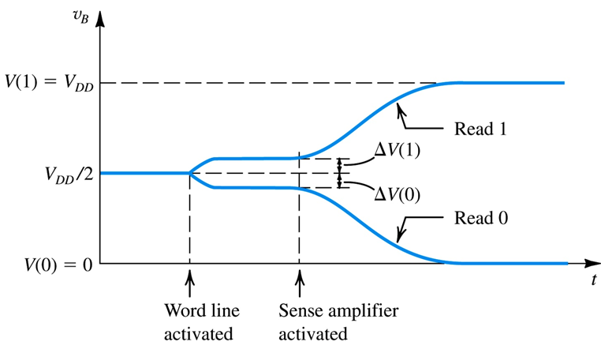
A Sense Amplifier for the 1-T Cell
The world line goes up and the charge redistribution occurs, creating a small difference between bitline voltages.
This small “readout” ΔV reaches the input of the amplifier latch, which is in the middle unstable state and slightly shifts it out of that state into one or another side, depending on the sign of ΔV
The latch switches to one of the stable points V_{L} or V_{H} and stays there as long as needed.

Slide 78
A Sense Amplifier for the 1-T Cell
The world line goes up and the charge redistribution occurs, creating a small difference between bitline voltages.
This small “readout” ΔV reaches the input of the amplifier latch, which is in the middle unstable state and slightly shifts it out of that state into one or another side, depending on the sign of ΔV .
The latch switches to one of the stable points V_{L} or V_{H} and stays there as long as needed.
Developing the precise expressions for the output of the sense amplifier is a difficult task because the large signal models have to be used and the positive feedback should be taken into the account.

Slide 79
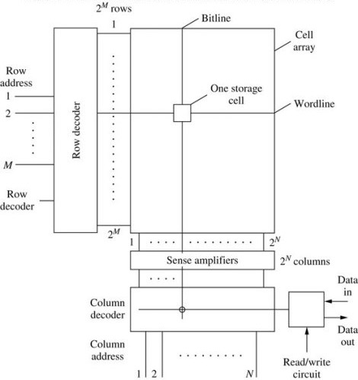
Memory Chip Organization
The memory usually is organized in a square (or nearly) matrix of storage cells.
The matrix has 2^{M} rows and 2^{N} columns for a total of 2^{M+N} cells that store 2^{M+N} bits
Each cell is tied to one of the 2^{M} row (word)-lines and to one of the 2^{N} digit (bit) lines.
A particular cell is selected by activating one wordline and one bitline.

Slide 80
Memory Chip Organization
The memory usually is organized in a square (or nearly) matrix of storage cells.
The matrix has 2^{M} rows and 2^{N} columns for a total of 2^{M+N} cells that store 2^{M+N} bits
Each cell is tied to one of the 2^{M} row (word)-lines and to one of the 2^{N} digit (bit) lines.
A particular cell is selected by activating one wordline and one bitline.
Activation of one of the woldlines is done by row address decoder that raises the voltage of the line, whose address is at decoder's input.

Slide 81
Memory Chip Organization
The memory usually is organized in a square (or nearly) matrix of storage cells.
The matrix has 2^{M} rows and 2^{N} columns for a total of 2^{M+N} cells that store 2^{M+N} bits
Each cell is tied to one of the 2^{M} row (word)-lines and to one of the 2^{N} digit (bit) lines.
A particular cell is selected by activating one wordline and one bitline.
Activation of one of the woldlines is done by row address decoder that raises the voltage of the line, whose address is at decoder's input.
When Kth row (word) is selected, all 2^{N} cells provide their content to the respective bit lines and their voltage will be changed by a small amount.

Slide 82
Memory Chip Organization
The memory usually is organized in a square (or nearly) matrix of storage cells.
The matrix has 2^{M} rows and 2^{N} columns for a total of 2^{M+N} cells that store 2^{M+N} bits
Each cell is tied to one of the 2^{M} row (word)-lines and to one of the 2^{N} digit (bit) lines.
A particular cell is selected by activating one wordline and one bitline.
Activation of one of the woldlines is done by row address decoder that raises the voltage of the line, whose address is at decoder's input.
When Kth row (word) is selected, all 2^{N} cells provide their content to the respective bit lines and their voltage will be changed by a small amount.
It will be amplified in the sense amplifier and the normal digital word (combination of bits) will enter into the column decoder.

Slide 83
Memory Chip Organization
The memory usually is organized in a square (or nearly) matrix of storage cells.
The matrix has 2^{M} rows and 2^{N} columns for a total of 2^{M+N} cells that store 2^{M+N} bits
Each cell is tied to one of the 2^{M} row (word)-lines and to one of the 2^{N} digit (bit) lines.
A particular cell is selected by activating one wordline and one bitline.
Activation of one of the woldlines is done by row address decoder that raises the voltage of the line, whose address is at decoder's input.
When Kth row (word) is selected, all 2^{N} cells provide their content to the respective bit lines and their voltage will be changed by a small amount.
It will be amplified in the sense amplifier and the normal digital word (combination of bits) will enter into the column decoder.
The column decoder selects a signal of a column whose Nbit address is applied to the decoder’s input.
That signal will appear on the data out line.

Slide 84
Memory Chip Organization
The memory usually is organized in a square (or nearly) matrix of storage cells.
The matrix has 2^{M} rows and 2^{N} columns for a total of 2^{M+N} cells that store 2^{M+N} bits
Each cell is tied to one of the 2^{M} row (word)-lines and to one of the 2^{N} digit (bit) lines.
A particular cell is selected by activating one wordline and one bitline.
Activation of one of the woldlines is done by row address decoder that raises the voltage of the line, whose address is at decoder's input.
When Kth row (word) is selected, all 2^{N} cells provide their content to the respective bit lines and their voltage will be changed by a small amount.
It will be amplified in the sense amplifier and the normal digital word (combination of bits) will enter into the column decoder.
The column decoder selects a signal of a column whose Nbit address is applied to the decoder’s input.
That signal will appear on the data out line.
The matrix organization allows to shorten the length of address → the length of bit/word lines → their resistance and capacitance → increase the speed of memory work.

Slide 85

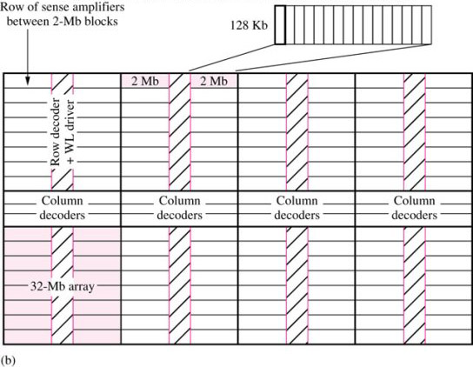
A 256-Mbit Memory Chip
The figure shows the block structure of a 256-Mb memory
The memory is organized as the matrix of blocks: the basic building block for this memory is a 128Kb cell.
This is done to additionally shorten the address, which now will appear as 3D address: {block, row, column}.
There are sets of column and row decoders that are used for memory array selection.
The column decoder splits the memory into upper and lower halves.

Slide 86
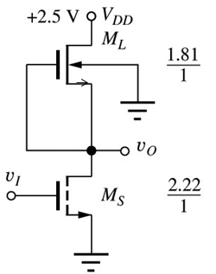
Address Decoders
Two major types of decoders are used.
NMOS row and column address decoders to select a single row/column
NMOS pass transistor tree decoders for selecting groups of data bits.
NMOS NOR Decoder (2 bit example)
It has 2-bit address A and 4 world lines:
W₀= 1 if A=00; W₁= 1 if A=01; W₂= 1 if A=10; W₃= 1 if A=11.
Which means:
Thus each W_{i} can be realized as a NOR gate that has as input a combination of true and inverted bits of address A.
We will consider an example of inverter built on NMOS gate with depletion load.
For each W_{i} we’ll have a NOR gate with two inputs tied to appropriate true and inverted bits of A.

Slide 87
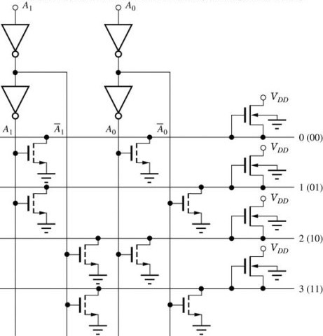
NMOS NOR Decoder
The address enters in the true
“1” address “0”

Slide 88
NMOS NOR Decoder
The address enters in the true and complementary form.
“1” address “0”

Slide 89
NMOS NOR Decoder
The address enters in the true and complementary form.
Each row is a NMOS NOR gate with two inputs connected to certain combination of bits of address and outputs connected to the word lines.
“1” address “0”

Slide 90
NMOS NOR Decoder
The address enters in the true and complementary form.
Each row is a NMOS NOR gate with two inputs connected to certain combination of bits of address and outputs connected to the word lines.
The output of each NOR gate is low when any of the inputs are high ( at least one transistor is on).
“1” address “0”

Slide 91
NMOS NOR Decoder
The address enters in the true and complementary form.
Each row is a NMOS NOR gate with two inputs connected to certain combination of bits of address and outputs connected to the word lines.
The output of each NOR gate is low when any of the inputs are high ( at least one transistor is on).
“1” address “0”

Slide 92
NMOS NOR Decoder
The address enters in the true and complementary form.
Each row is a NMOS NOR gate with two inputs connected to certain combination of bits of address and outputs connected to the word lines.
The output of each NOR gate is low when any of the inputs are high ( at least one transistor is on).
“1” address “0”

Slide 93
NMOS NOR Decoder
The address enters in the true and complementary form.
Each row is a NMOS NOR gate with two inputs connected to certain combination of bits of address and outputs connected to the word lines.
The output of a NOR gate is high only when both inputs are low (both transistors are off ).
“1” address “0”

Slide 94
NMOS NOR Decoder
The address enters in the true and complementary form.
Each row is a NMOS NOR gate with two inputs connected to certain combination of bits of address and outputs connected to the word lines.
The output of a NOR gate is high only when both inputs are low (both transistors are off ).
For every input, only one output line will be high – the rest will be always low.
“1” address “0”

Slide 95
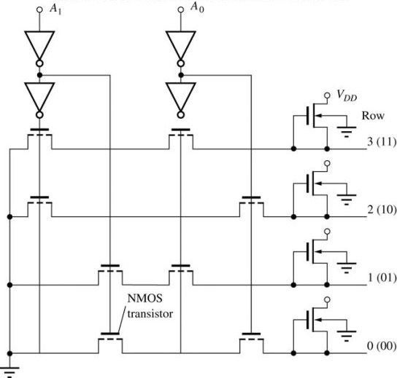
NMOS NAND Decoder
“1” address “0”
Similar design can be done using NAND gates.
Each row is a NMOS NAND gate with two inputs connected to certain combination of bits of address and outputs connected to the word lines.
However here the situation will be inverted:
All rows will be high.

Slide 96
NMOS NAND Decoder
“1” address “0”
Similar design can be done using NAND gates.
Each row is a NMOS NAND gate with two inputs connected to certain combination of bits of address and outputs connected to the word lines.
However here the situation will be inverted:
All rows will be high.

Slide 97
NMOS NAND Decoder
“1” address “0”
Similar design can be done using NAND gates.
Each row is a NMOS NAND gate with two inputs connected to certain combination of bits of address and outputs connected to the word lines.
However here the situation will be inverted:
All rows will be high.

Slide 98
NMOS NAND Decoder
“1” address “0”
Similar design can be done using NAND gates.
Each row is a NMOS NAND gate with two inputs connected to certain combination of bits of address and outputs connected to the word lines.
However here the situation will be inverted:
All rows will be high.
And only one row will be low that correspond to the given address.
Thus we would need to invert the signal coming to the wordlines, which is not a problem since anyway , additional driver circuits are required between the decoder and highly capacitive wordlines.

